Slide 1

SilQ - QCodes
A new era begins…

Slide 2

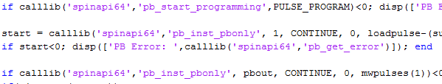
Why
Need to free ourselves from the rule of bad very task specific coding

Slide 3


Slide 4
Python
Basic differences
Tabs
No semicolons
https://docs.python.org/2/tutorial/

Slide 5
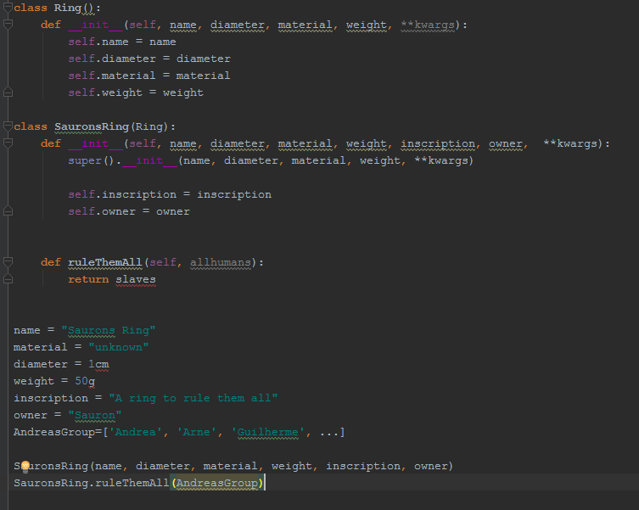

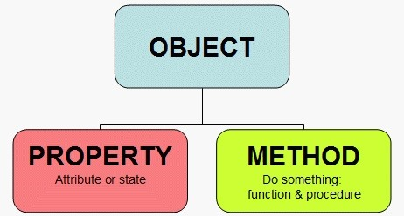

Object oriented programming
SuperClass
Properties
Class
Initialization
Properties
Method
Instance

Slide 6
Silq and QCodes

Slide 7



The interpreters

Slide 8
Notebook

Slide 9
PyCharm

Slide 10
Real time measurement
http://129.94.115.27:8889/

Slide 11

Installation

Slide 12


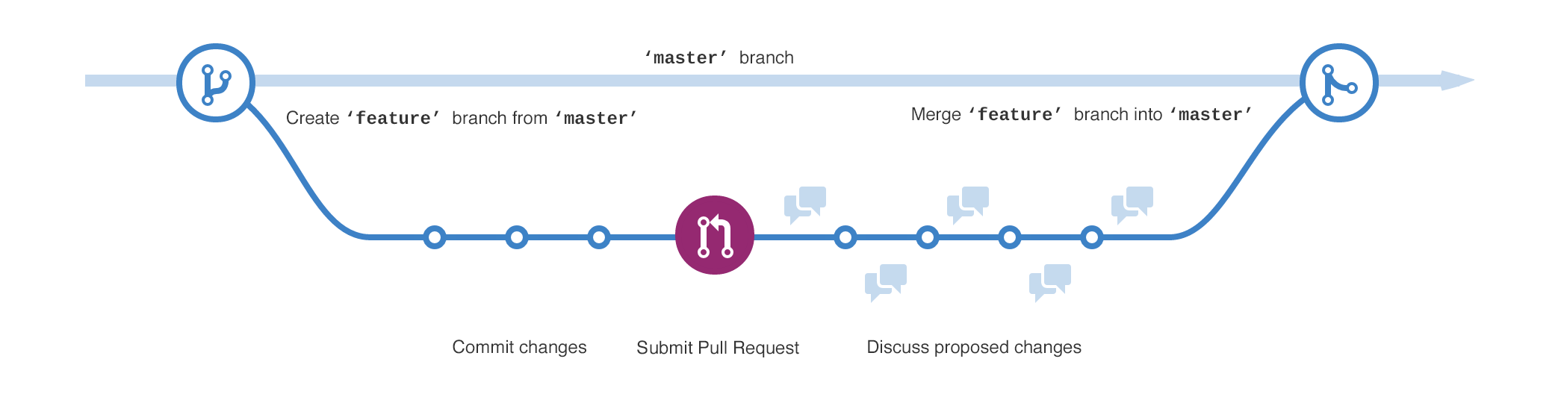
github

Slide 13

Coding rules
Python
Use 4 spaces per indentation level (use tabs)
Surround top-level function and class definitions with two blank lines Method definitions inside a class are surrounded by a single blank line.
imports should usually be on separate lines, on top of the file and absolute from mypkg import sibling
Modules should have short, all-lowercase names. Underscores can be used in the module name if it improves readability. Python packages should also have short, all-lowercase names, although the use of underscores is discouraged
Class names should normally use the CapWords convention
Function names should be lowercase, with words separated by underscores as necessary to improve readability
Always use self for the first argument to instance methods
Method Names and Instance Variables
Use the function naming rules: lowercase with words separated by underscores as necessary to improve readability
Constants are usually defined on a module level and written in all capital letters with underscores separating words. Examples include MAX_OVERFLOW and TOTAL
Public attributes should have no leading underscores 1 leading underscore is private (_single_leading_underscore: weak "internal use" indicator. E.g. from M import * does not import objects whose name starts with an underscore) 2 leading underscores are “private” instance variables
__foo__: this is just a convention, a way for the Python system to use names that won't conflict with user names.
_foo: this is just a convention, a way for the programmer to indicate that the variable is private (whatever that means in Python).
__foo: this has real meaning: the interpreter replaces this name with _classname__foo as a way to ensure that the name will not overlap with a similar name in another class.
foo = long_function_name(var_one, var_two,
var_three, var_four)
Us
No abbreviations
Write descriptive comments

Slide 14
The journey is not over yet…

